Slide 1
Filming Attack on SmartPhones while Charging
ECE209AS Winter 2018 Project
Shoban Narayan Ramesh
UID:604741670

Slide 2
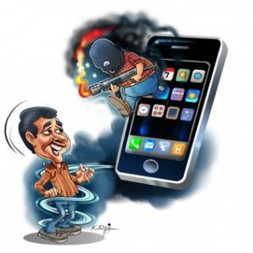
Introduction
With increase use of smartphone in day to day life, the challenges to maintain the privacy of Smartphone users has increased.
A number of malware attacks such as Soundcomber[3], Screenmilker[2], have been spread.
These attacks are either based on physical access or through malwares injected into the device through the network.
Image derived from http://labnium.org/how-to-protect-safeguard-android-smart-phone-from-cyber-attacks/

Slide 3
Abstract
This project demonstrates an attack where the smartphone screen is recorded on connecting to a tampered unauthorized charger. The screen recording is further processed to obtain the unlock password of a Smartphone.
The vulnerability exploited in this attack is that when a MHL/HDMI supported smartphone (Android/iOS) is connected to a projector through a HDMI/VGA cable there are no permission requests or authentication steps required for connectivity
This vulnerability was spotted and exploited in a paper called “Charging Me and I Know Your Secrets! Towards Juice Filming Attacks on Smartphones” [1] .
This project is a demonstration of the attack explained in the aforementioned paper, which is then extended to extract the unlock passwords from the video recordings.

Slide 4
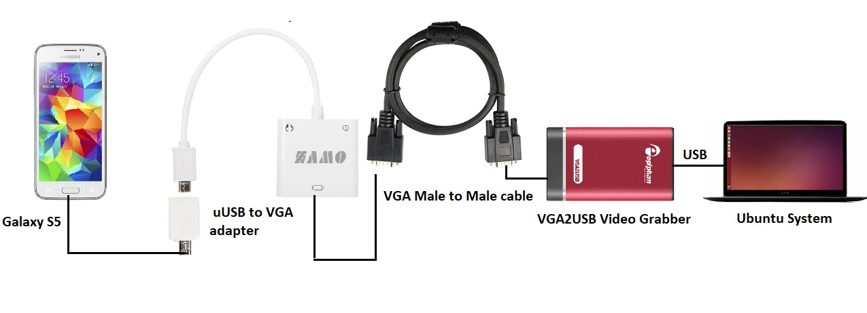
Components and Setup
The components used in this attack are the following:
Samsung Galaxy S5 – MHL Supported phone
VGA2USB convertor (Only supports MHL)
Epiphan VGA2USB Video grabber
VGA Male to Male convertor
Ubuntu System (Kernel version 4.10.0-28)

Slide 5
Methodology and Implementation
auto_record.sh continuously detects if there is an incoming video signal and records it. Whenever the video signal is disconnected, implying the phone is removed from the charger, the recorded video is saved with a name having the recorded date and time.
The recorded video is then divided into frames and saved at a particular location using the same ffmpeg package used to record the video. This is governed by the script frame_gen.sh
Password_extract.py processes the frames to extract the unlock passwords of the phone
There are a couple of techniques to recognize the characters pressed, some of them are [5] and [6]:
Structural Similarity (ssim)
Mean Squared Error[7]
Template Matching
Optical Character recognition.

Slide 6
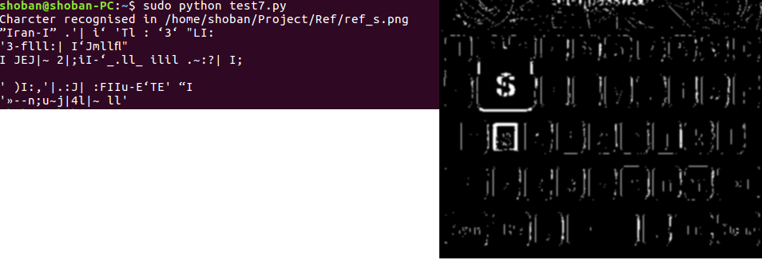
Technique for image comparison
Optical character recognition can be implemented with the package named pytesseract and this technique is a generalised technique which can recognise the key presses of any keyboard. However when I tried implementing this method its accuracy was really poor and it threw garbage values. [8]
I implemented the logic for password extraction with structural similarity [7] as well and found it had an accuracy better than the optical character recognition, however this technique will work only with the trained keyboard reference images and cannot be extended to the same keyboard of another phone or other keyboards.
Mean squared error is a poor measure of comparing two images, it only gives the perceived errors and not a direct measure of their similarity.

Slide 7
Challenges
Epiphan VGA2USB driver – This company has stopped making drivers for recent kernel versions of Ubuntu.
Choosing a suitable frame rate – Frame rate was difficult to choose as more was the frame rate, there were more frames having the same key presses, this would lead to multiple key detections. Having a lower frame rate sometimes drops the key presses.
Frame Comparisons- Choosing the right technique for frame comparison

Slide 8
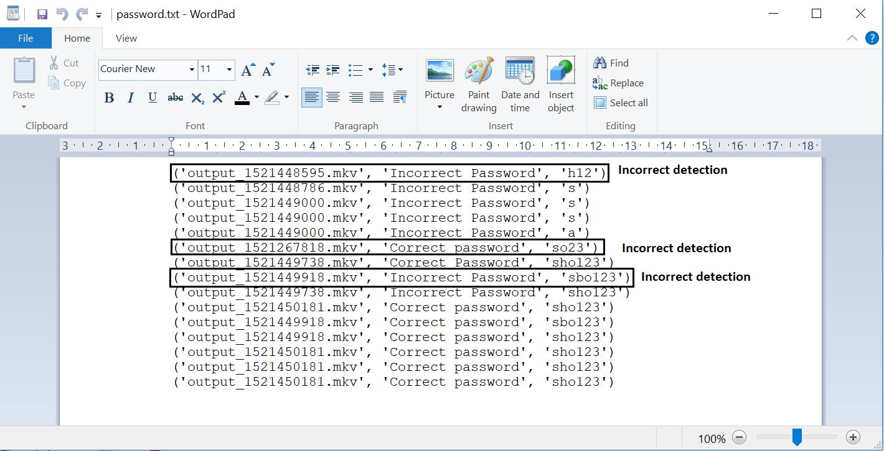
Results

Slide 9
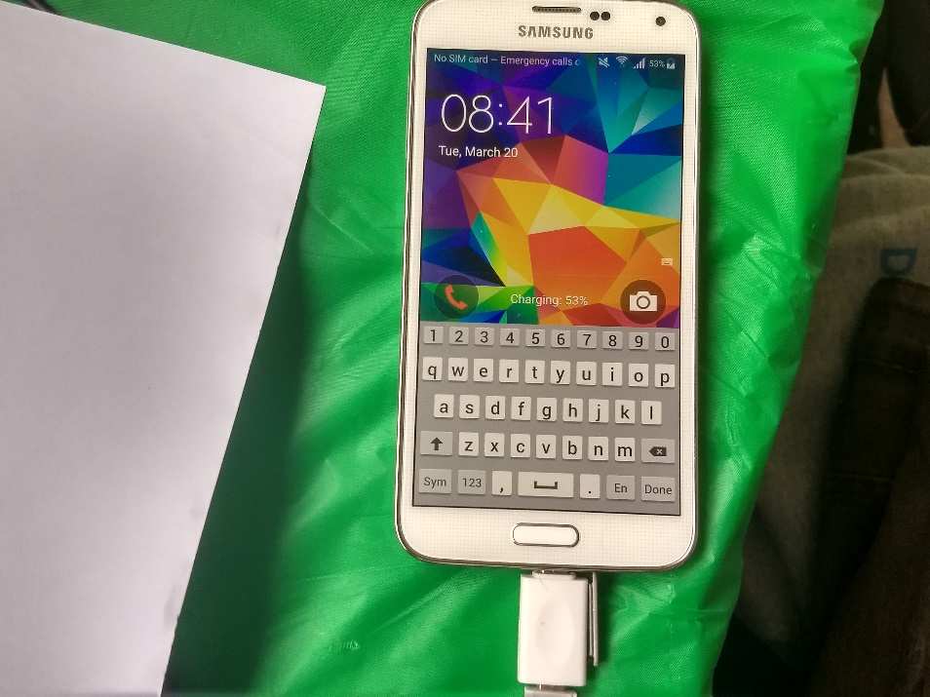
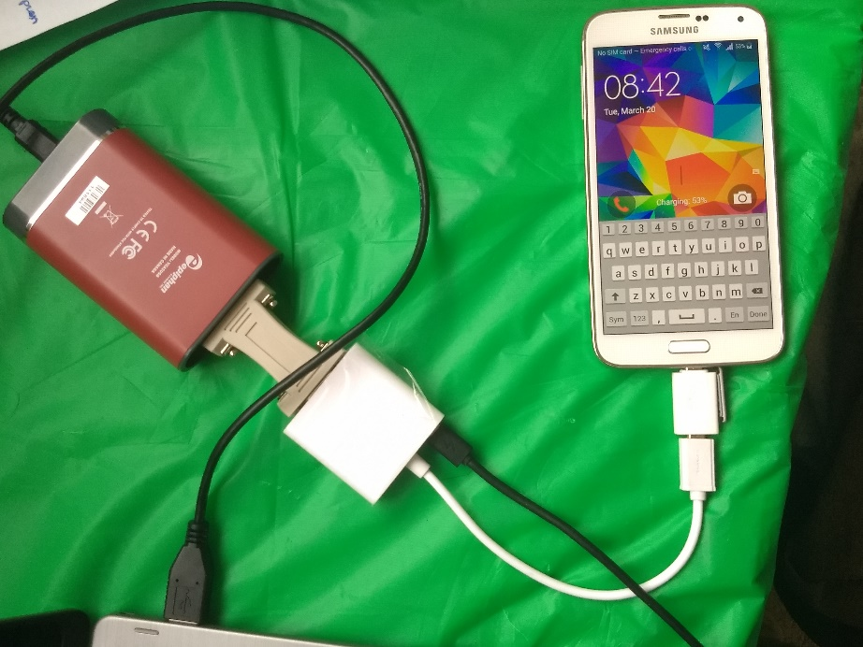
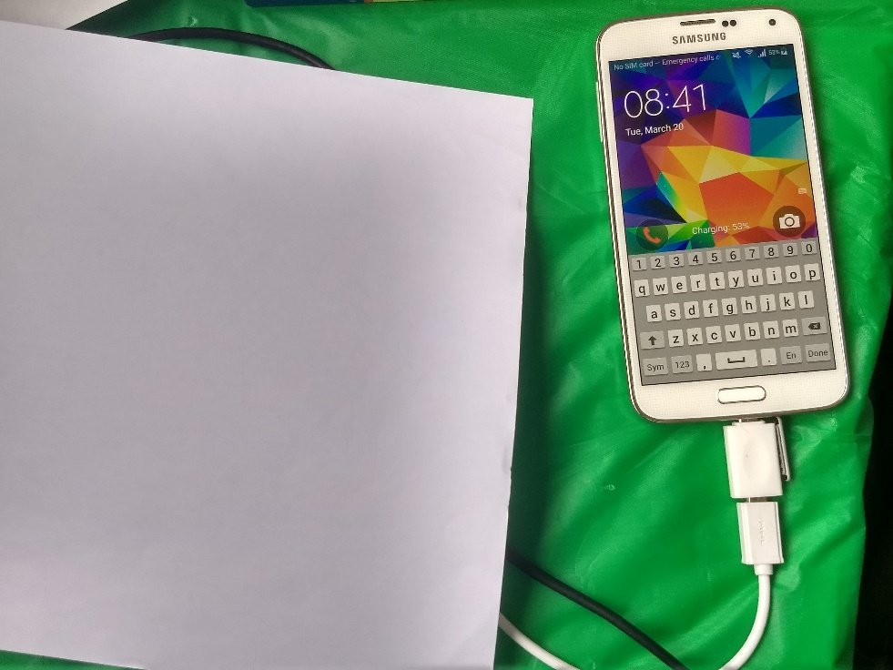

Slide 10
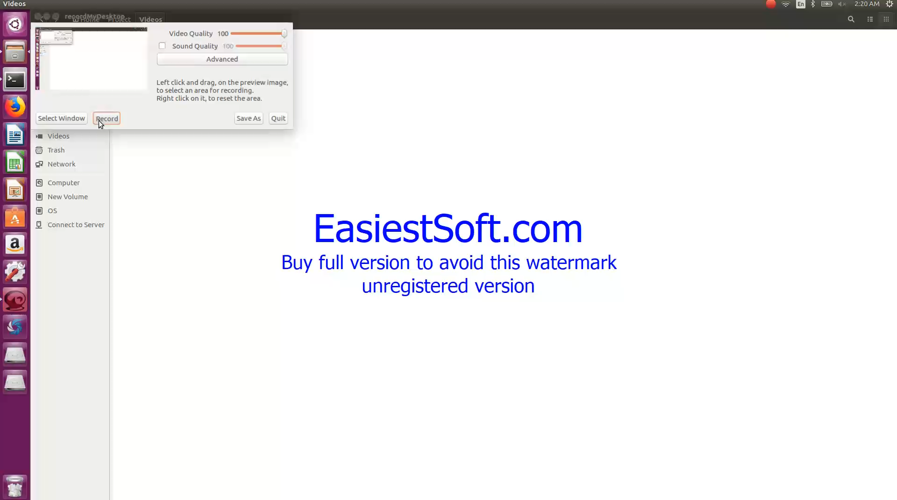
Demo

Slide 11
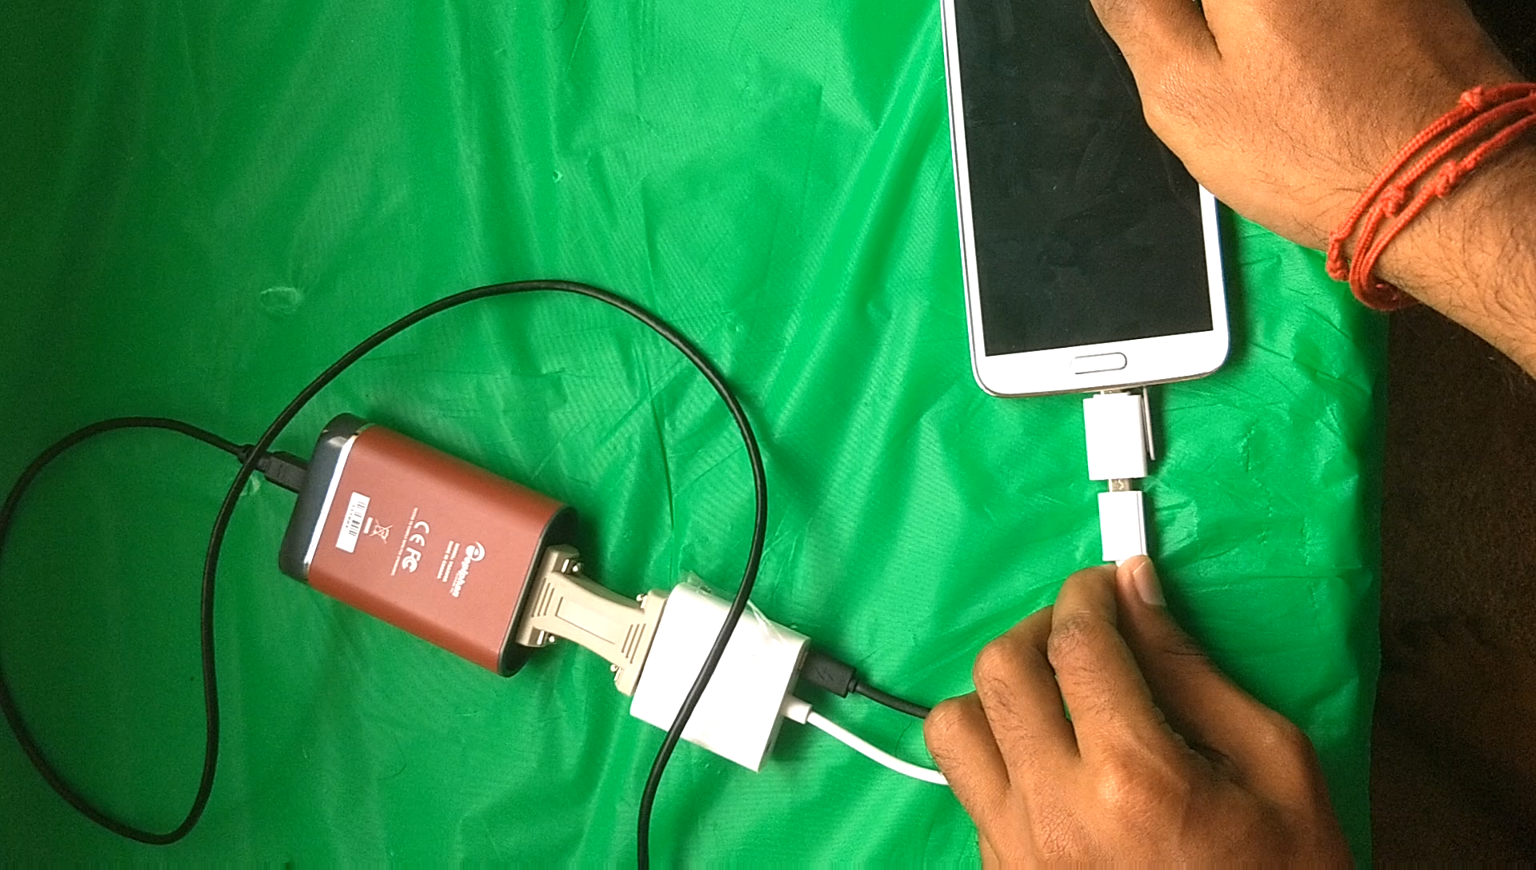

Slide 12
Analysis
A new video is recorded the each time the device is connected to the charger and the video is named with the time and date of recording. However it doesn’t have a device ID to track if the same device is connected back again.
Frame rate selected for video recording is 10 fps. VGA2USB grabber supports a maximum frame rate of 28, which has the least resolution of 640x480. In order to strike a balance between better resolution and frame rate, frame rate was chosen to be as 10, which gives a resolution of 1024x768.
The results obtained depend on the speed of typing and the pressure applied while pressing the keys.

Slide 13
Strengths
This attack is simple to implement.
No need to install any apps on phone.
No need of any permissions.
It cannot be detected by any of the anti-malware software.
It can be implemented in both Android and iOS phones.
This attack has a good accuracy in detecting the pressed characters with standard qwerty keyboard and also has the logic to detect incorrect passwords, removal of characters from passwords.

Slide 14
Weakness
Following are the limitations with respect to the feasibility and accuracy of the demonstrated attack.
Some of the Smart phone manufacturers such as Lenovo, MI, Google Nexus and other Chinese brands do not support MHL or HDMI facility.
Some mobile phones from Samsung such as Galaxy S5 give a momentary notice to the users saying HDMI cable connected
Template matching works best only with the standard qwerty keyboard.
This attack cannot extract auto saved passwords.
This attack can only detect the characters pressed in the first page of the standard qwerty keyboard as it has been trained only with the reference templates pertaining to the first page of the keyboard.

Slide 15
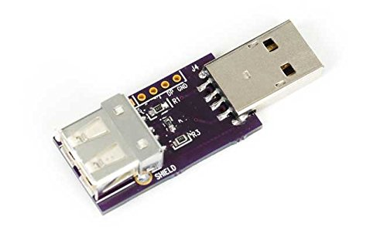
Mitigation Strategies
Some measures to mitigate this attack are the following:
Enabling the Smartphone’s operating system to warn and notify the user when an external display device connects to the phone.
Use of mobile phone accessories such as USB condoms while charging in public charging booths.
Use of biometric impressions to unlock the phone.
Carrying your own charger.

Slide 16
Future Work
Possible future work with this attack includes the following:
Increasing the accuracy of recognising the character pressed by using machine learning.
Extracting other private and secure information from the videos like the email messages, pictures and passwords to financial service Apps etc.

Slide 17
References
Meng, Weizhi, Wang Hao Lee, S. R. Murali, and S. P. T. Krishnan. "Charging me and i know your secrets!: towards juice filming attacks on smartphones." In Proceedings of the 1st ACM Workshop on Cyber-Physical System Security, pp. 89-98. ACM, 2015.
Lin, Chia-Chi, Hongyang Li, Xiao-yong Zhou, and XiaoFeng Wang. "Screenmilker: How to Milk Your Android Screen for Secrets." In NDSS. 2014
Schlegel, Roman, Kehuan Zhang, Xiao-yong Zhou, Mehool Intwala, Apu Kapadia, and XiaoFeng Wang. "Soundcomber: A Stealthy and Context-Aware Sound Trojan for Smartphones." In NDSS, vol. 11, pp. 17-33. 2011.
https://www.geeksforgeeks.org/template-matching-using-opencv-in-python/
https://stackoverflow.com/questions/11541154/checking-images-for-similarity-with-opencv/11541587
https://stackoverflow.com/questions/45386603/simple-way-to-compare-two-images-in-python
https://www.pyimagesearch.com/2014/09/15/python-compare-two-images/
https://www.pyimagesearch.com/2017/07/10/using-tesseract-ocr-python/
https://askubuntu.com/questions/700214/how-do-i-install-an-old-kernel

